Slide 1

Iowa Graduate Business Analytics Case Competition
By: Team 13

Slide 2
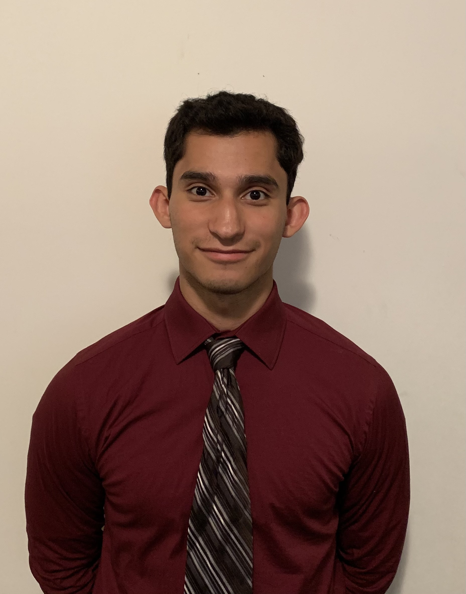
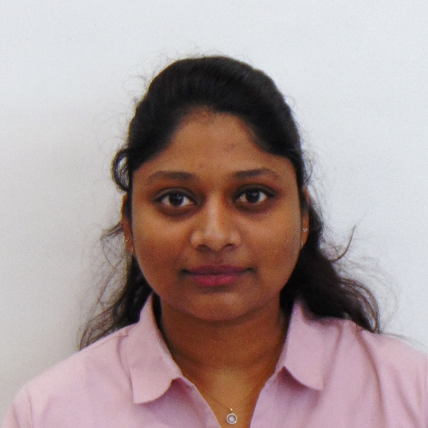
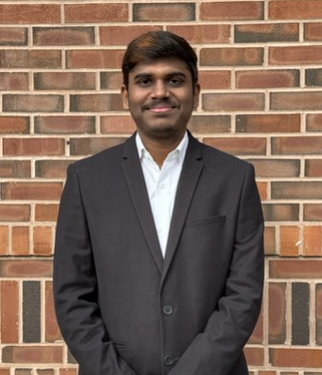
Meet the Team
Aakash Ramasubramanian
Srikanth Babu Kotapati
Joel Esparza
Jayashree Dommara

Slide 3
Ball Corporation Business Problem

Slide 4
State the problem & situation

Slide 5
Data Exploration

